Slide 1

REGISTRATION AND LICENCING UNDER THE PROPERTY PRACTITIONERS ACT 22/2019

Slide 2
CHANGES IN REGISTRATION UNDER THE PPA
LEGISLATION (PROPERTY PRACTITIONERS ACT 22/2019)
Legislation dictates all PPRA mandates and processes. Changes require adaptation:
1. Registration and Licencing:
Industries- 12 industries
FFCs- floating FFC for individuals, FFCs for firms, 3 year validity
Costs- FFC cost, Registration FF once-off payment, admin fees.
Exemption applications- exemption fee, E1 form, process.
2. Education
3. Enforcement
4. Transformation

Slide 3
12 CATEGORIES OF PROPERTY PRACTITIONERS REQUIRED TO REGISTER WITH THE PPRA
Estate agents
Auctioneers
Bond and bridging finance originators
HOAs who perform property practitioner activities
Managing agents
Property facilitators and intermediaries
7. Business brokers, including sales of franchises and business undertakings.
8. Developers who market and sell their own developed property
9. Time share and fractional ownership practitioners
Property advertising platforms who perform property practitioner activities
Property practitioners who specialise in collecting and distributing trust monies in terms of Regulation 2.4.1. (Payment processing agents)
12. Attorney employees

Slide 4
HISTORICAL LEGISLATED FRAMEWORK
EACH FIRM HAD ITS OWN FFC
EACH FIRM HAD A PRINCIPAL AND EMPLOYEES
EACH PRINCIPAL AND EMPLOYEE HAD AN INDIVIDUAL FFC UNDER THE SPECIFIC FIRM WHICH HE / SHE WAS EMPLOYED BY
EACH BRANCH OF A FIRM HAD ITS OWN FFC
EACH DIRECTOR HAD AN FFC INCLUDING NON EXECUTIVE DIRECTORS
EVERY FIRM AND PRINCIPAL HAD A TRUST ACCOUNT FOR WHICH THE PRINCIPAL WAS RESPONSIBLE
EACH FIRM, PRINCIPAL, EMPLOYEE AND BRANCH PAID FOR EACH FFC TO BE ISSUED.

Slide 5
WHAT’S CHANGED?
EACH FIRM HAS ITS OWN FFC
EACH ESTATE AGENT FIRM HAS A PRINCIPAL AND EMPLOYEES
EACH NON-ESTATE AGENT FIRM HAS A DIRECTOR AND EMPLOYEES
EACH PRINCIPAL AND EMPLOYEE HAVE ONLY ONE FFC
EACH BRANCH OF A FIRM HAS ITS OWN FFC
EACH DIRECTOR HAS AN FFC BUT NON EXECUTIVE DIRECTORS APPLY FOR AN EXEMPTION AND DO NOT REGISTER
FRIMS CAN APPLY FOR AN EXEMPTION FROM A TRUST ACCOUNT IF THEY DO NOT RECEIVE TRUST MONEY
ONLY NATURAL PERSONS PAY FOR FFCs.
ADMIN FEES ARE PAYABLE FOR SERVICES NOT CHARGED FOR UNDER THE PPA.
Reg. 41.22
“Where a natural person acts as a property practitioner in different capacities within the same industry, a single fidelity fund certificate shall be issued to that natural person in respect of all capacities in which they act as a property practitioner within that industry.”
Reg. 25.1 /26.2
Every firm is to hold an FFC in every industry in which it operates

Slide 6
EFFECTS OF THE INDUSTRY BASED “FLOATING” FFC
Principal, employees and firm FFC’s are no longer interdependent, but are independently issued.
When a principal renewed his own FFC under a specific firm, the firm FFC generated and issued automatically. If he did not renew under his firm, no firm FFC or agent FFC would issue. Now firm FFCs are applied for separately.
Employee FFCs issued based on firm and principal FFC. Employee FFCs still depend on the compliance of the firm and the principal.
Principal: 1 floating INDIVIDUAL FFC for all firms.
Employees: 1 floating FFC for all employers (1 employer for candidate and FSA).
Principals must remember to renew their own FFC when it expires as well as the firm FFC when it expires. They might not coincide.
PRINCIPAL JOE HAS 3 FIRMS:
3 FFCs issued to him, valid from 1/1/ 2023 (2) and 1/1/2025 (1), and expire in 2025 and 2027 respectively.
MONEY BAGS REALTY PTY LTD - FIRM FFC expires 2025
MY PROPERTY CC - FIRM FFC expires 2027
PAY ME NOW ESTATES - FFC- expires 2025
JOE Does not need a new FFC until Oct 2027. No renewal paid or required.
2025: Money Bags and Pay Me Now firms need to pay an admin fee and get new FFCs.
2027: Joe will apply for his new floating FFC. It will not be issued under any firm.
He must submit renewal documents for himself and his current firms.
2027: He will have to renew My Property FFC when he renews his own and pay admin fee.

Slide 7
SUMMARY
CURRENTLY:
Practitioners under more than 1 firm have multiple FFCs expiring at different times.
While one of the FFCs is valid, there is no need to apply for a renewal.
Once all existing principal FFCs have expired, the next FFC applied for and issued for the principal will not be associated with any firm.
All firm FFCs must be renewed when they expire.
Natural firms pay FFC fee.
Firms pay admin fee.
NOTE:
No application form will be required for a firm FFC to be issued. The firm CIPC documents, new BEE certificate (juristic persons) tax clearance certificates (all firms) and proof of payment of the admin fee, are required. (Regulation 15(5) and 15(6) do not apply to firms)
When the principal renews his floating FFC he will apply as required by regulation 21 and submit compliant documents for himself. He only pays the FFC fee for his own single FFC.
When a principal is added to an existing firm or registers a new firm under him, he does not get a new FFC, only the firm gets an FFC and payment of the admin fee for the firm FFC and the agent’s amendment of records, are required.

Slide 8
SUMMARY CONTINUED
Employees’ FFCs are not issued under any firm but their FFC is dependent on the principal and firm FFC as they operate under one firm.
Firms FFCs must be created using a separate function. Principals will need to request and pay an admin fee for their new firm FFC, when it expires,
Firm FFCs will still only generate if their principal has a valid current floating FFC under any one firm in the industry.
Principals still pay a 3 year FFC fee to renew their floating FFCs.
Employees still pay their 3 year FFC fee to renew their floating FFCs.
A principal who opens a new firm or joins a new firm, does not pay to be issued with a new FFC if he has a valid current floating FFC.
For him to be registered under that firm he will pay a R640 admin fee, as escalated annually.
For a new firm, the firm will not pay for an FFC as per regulation 15.1.
The firm will pay an admin fee of R640 escalating annually to assist in covering our costs in issuing FFCs to firms for free.
An employment change does not issue a new FFC.
A renewal application does not effect an employment change.
A status upgrade must be requested after your qualifications have been updated by education and does not issue a new FFC.

Slide 9
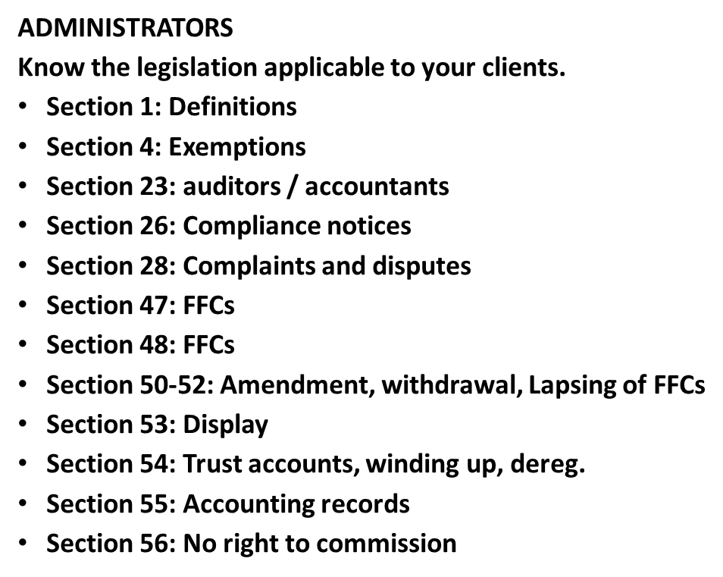
PROPERTY PRACTITIONERS SHOULD KNOW:
Section 58: Other service providers
Section 63: Undesirable Practices
REGULATIONS
R2: Exemptions
R15: FFC fees
R20-26: FFCs, format, deadlines, penalties, amendments, updating of details.
R31: Deregistration
R34: Code of Conduct
R38: fines and contraventions
R41.22-41: Registration and FFC administration.

Slide 10
NEW REGSITRATIONS PORTAL
CURRENTLY:
Registration of new agents
generation of pin numbers.
Submission of applications
Go to practitioners portal on website ( existing portal) - click new practitioner- takes you to new portal-click register
7 DIGIT PIN
Find industry- enter details, upload ID and employment letter-create password, submit.
You will receive an email –under review.
Currently we will send you the 7 digit reference number.
APPLICATION
Log in with that number to submit an application.
Complete the digital application form- upload required documents- submit-status will show and change as we process.
AFTER INTEGRATION:
7 digit pin will create automatically.
Application will be available immediately.
After verification FFC will show and be available for download.
Renewals will be available.
PHASE 2:
Reregistration, upgrades, employment change, queries, questions, status, and FFCs will be available online.

Slide 11
REGISTRATION REQUIREMENTS
NON ESTATE AGENT PRACTITIONERS- ALL OTHER INDUSTRIES: FIRM REGISTRATION
REGISTRATION IS BY A DIRECTOR
Required documents to upload:-
FIRM DOCUMENTS: CIPC or firm documents, bank letter confirming trust account held in terms of section 54(1) or trust exemption certificate, auditor’s letter of confirmation for entities holding a trust account, a company resolution, valid BEE certificate (not necessarily compliant), for juristic entities, SARS tax clearance certificate for all firms, proof of payment of statutory and administration fees.

Slide 12
REGISTRATION OF INDIVIDUAL PPs. (NON-ESTATE AGENTS)
DIRECTORS REGISTER THEMSELVES INDIVIDUALLY
REQUIRE:
ID document.
E1 form applying for exemption from Regulation 33,
Proof of payment of registration fee.
EMPLOYEES (ALL)
E1 form applying for exemption from Regulation 33 (education).
Letter of employment signed by director and employee, stating reference number of director and firm.
Proof of payment of registration fee.

Slide 13
REGISTRATION OF ESTATE AGENT PPs
PRINCIPALS REGISTER THEIR FIRM AND THEMSELVES INDIVIDUALLY AS PREVIOUSLY
FIRMS:THE SAME PROCESS AS FOR NON-ESTATE AGENT BUSINESS PROPERTY PRACTITIONER PRINCIPALS
PRINCIPALS submit the following documents:
ID document.
Proof of payment of registration fee.
CANDIDATES
Letter of employment signed by director and employee, stating reference number of director and firm,
Proof of payment of registration fee

Slide 14
GENERAL CHANGES
Format of FFCs
Upgrades and employment change - no FFC issued
Why administrative fees are payable
Requests for upgrades required –education updates, then request to upgrade
Time periods for issuing of FFCs
Floating FFCs
Renewal of firms separate to practitioner

Slide 15
FOR NOTING
Section 4 exemptions / equivalency exemptions / trust account exemptions:
  Costs differ, address differs, criteria differ
  section4exemptions@theppra.org.za
  exemptions@theppra.org.za
  audit@theppra.org.za
  Exemption application form / prescribed affidavit reg.2.
  CPD Zandile.Mahlangu@theppra.org.za.
  Escalation to EM and CEO.
  Registration escalation- Vukani.Mbatha@theppra.org.za.
  Lerato.Molautsi@theppra.org.za

Slide 16

GENERAL
PLEASE:
Do not send an enquiry without a pin number.
Do not copy the EM and CEO on ordinary emails. Their emails are
for escalation or legal enquiries, not for general registration matters.
New website with search capability- Read notices on the website.
Do not send emails to multiple people.
Do not send emails 15 times a week.
Note the 30 working day turnaround time for FFCs. (S49).
Be accurate.
Be clear.
Do not ask for something that is prohibited by the PPA.
Report administrator dissatisfaction to the EM or Vukani first, then if you get no joy escalate to CEO.
CEO cannot give permission to be non-compliant, even if she wants to.
Report corruption.

Slide 17
THANK YOU
QUESTIONS

